Slide 1

Kubernetes for beginners

Slide 2
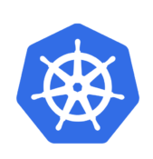

Content
In the following 45 minutes you will learn:
Why we need Kubernetes (what we did before) ?
What is Kubernetes ?
What are containers, pods and replica sets, services ?
Scale ?
Companies that use Kubernetes
How you can use Kubernetes ?

Slide 3


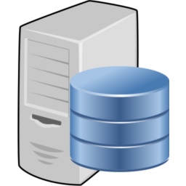

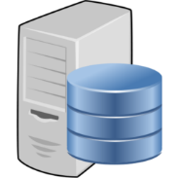

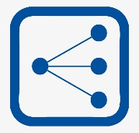


Before K8S

Slide 4
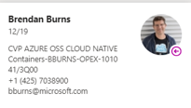
What is Kubernetes ?
Open-source system for automating deployment, scaling, and management of containerized applications
Was founded by Joe Beda, Brendan Burns, and Craig McLuckie in 2014

Slide 5
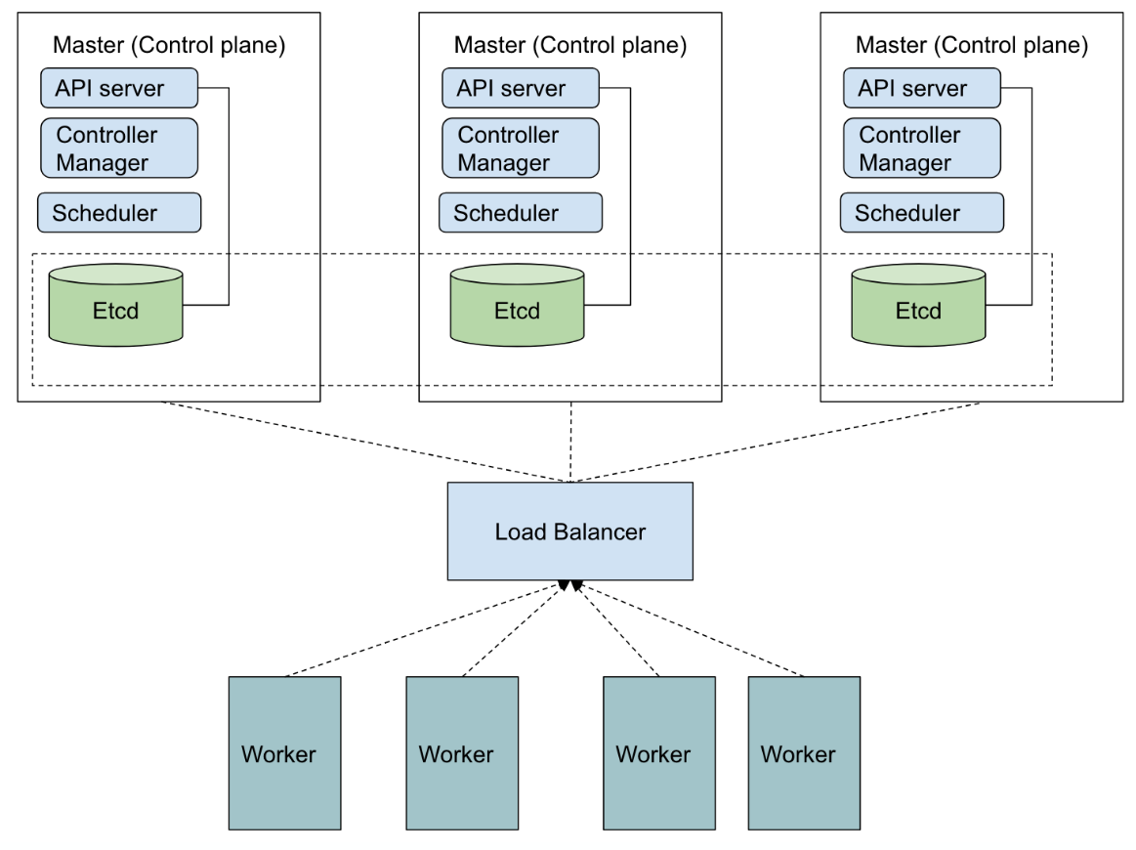
What is Kubernetes ?

Slide 6
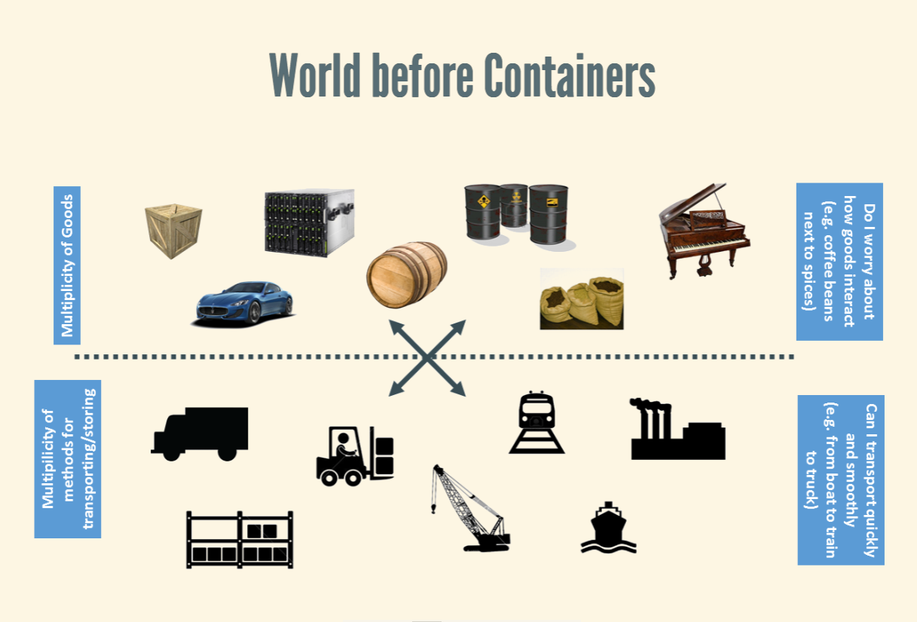
What are containers ?

Slide 7
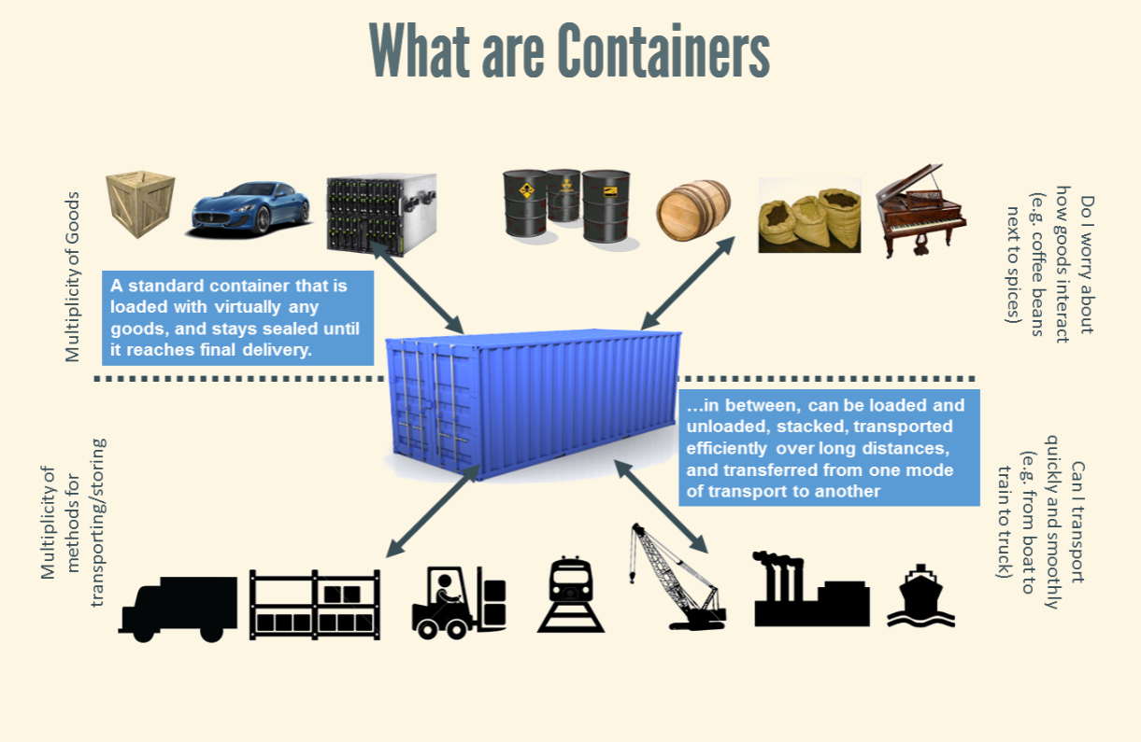

Slide 8
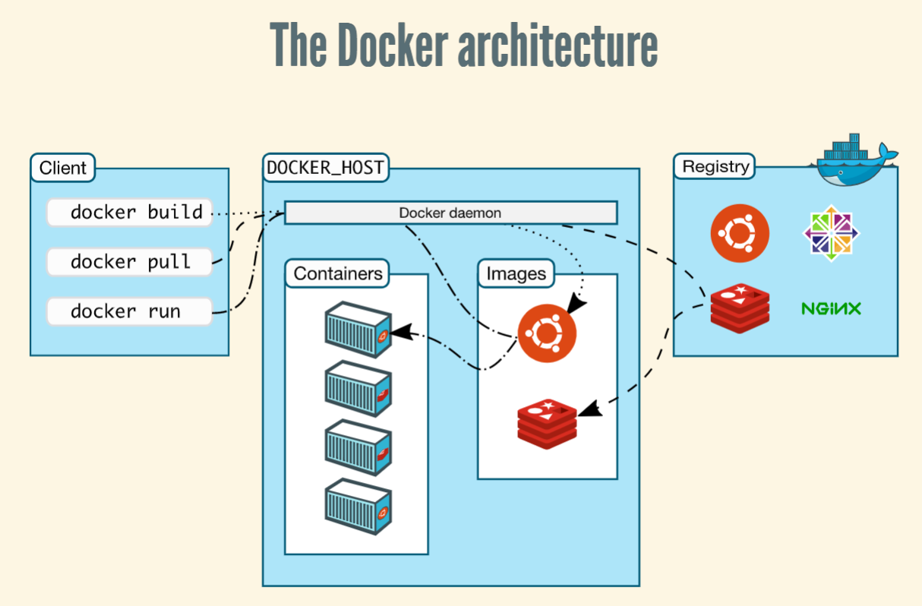

Slide 9
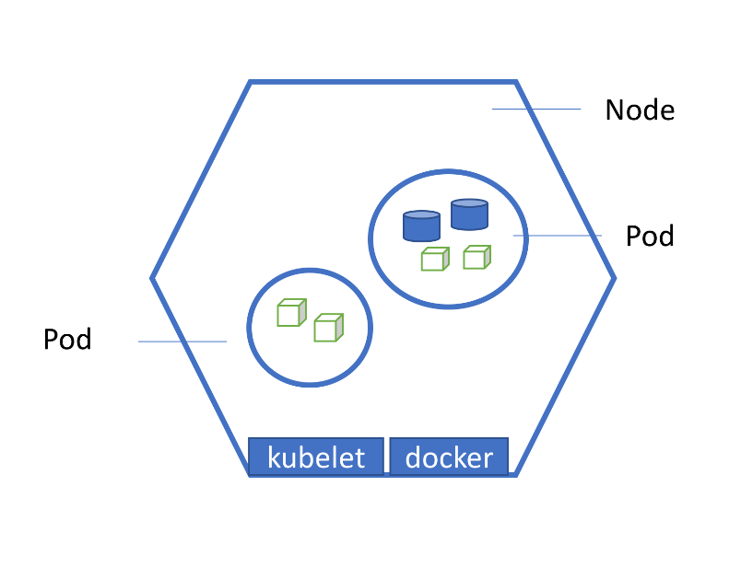
What are pods and replica sets ?
Pods:
Group of one or more containers.
Containers in the same pod have the same hostname.
Each pod is isolated with process id, network namespace, Time sharing.

Slide 10
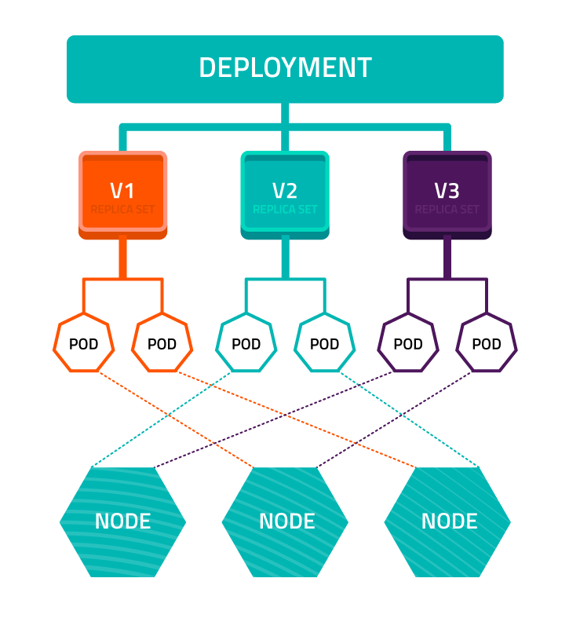
What are replica sets ?

Slide 11
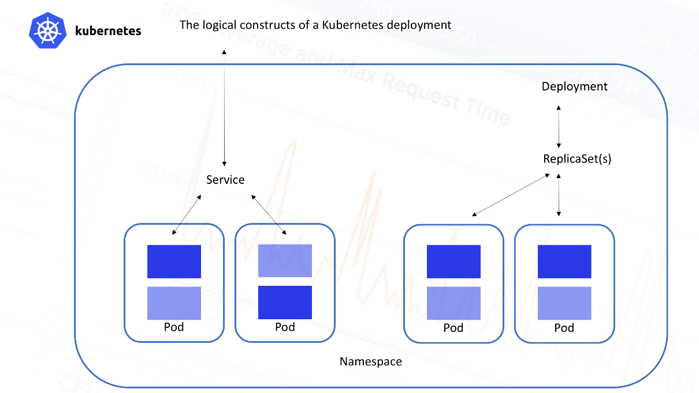
Services
Service types:
ClusterIP.
NodeIP.
LoadBalancer.

Slide 12

Scale ?

Slide 13
Scale ?
Nodes Autoscaler
HPA - Horizontal Pod Autoscaler
VPA - Vertical Pod Autoscaler

Slide 14
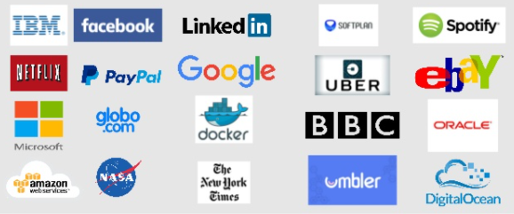
And many more ….

Slide 15

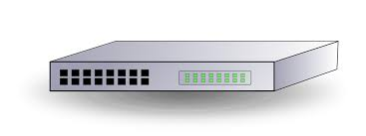
K8S in hardware (use case)

Slide 16
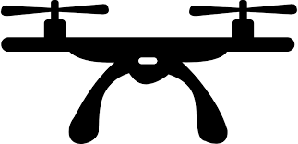
K8S in drones

Slide 17
K8S bond channel
https://teams.microsoft.com/l/channel/19%3a150323c2c32d45c3907ad4684a7bc3dc%40thread.skype/General?groupId=451c9a3b-1c63-499e-ba88-d576d176791f&tenantId=72f988bf-86f1-41af-91ab-2d7cd011db47

Slide 18
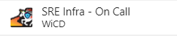
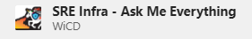

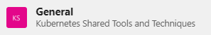
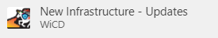
Channels

